Slide 1

Fundamentals of IT
BIT-01 B Tech-Ist year MMMUT, Gorakhpur
A
PDF on UNIT-4
Network Basics

Slide 2
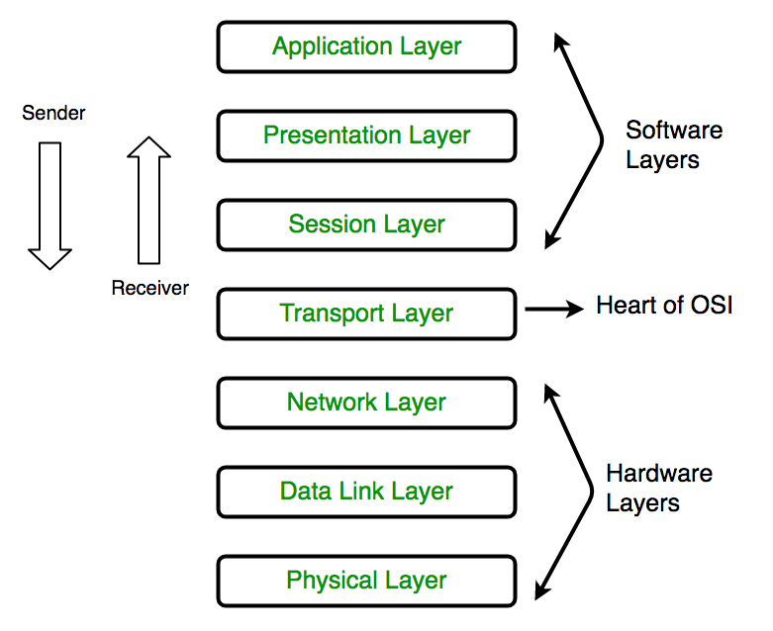
OSI Layers OSI stands for Open Systems Interconnection. It has been developed by ISO – ‘International Organization of Standardization‘, in the year 1984.

Slide 3
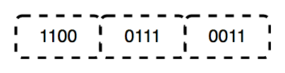
Physical Layer (Layer 1) :
The lowest layer of the OSI reference model is the physical layer. It is responsible for the actual physical connection between the devices. The physical layer contains information in the form of bits. It is responsible for transmitting individual bits from one node to the next. When receiving data, this layer will get the signal received and convert it into 0s and 1s and send them to the Data Link layer, which will put the frame back together.
Hub, Repeater, Modem, Cables are Physical Layer devices.
The functions of the physical layer are :
Bit synchronization: The physical layer provides the synchronization of the bits by providing a clock. This clock controls both sender and receiver thus providing synchronization at bit level.
Bit rate control: The Physical layer also defines the transmission rate i.e. the number of bits sent per second.
Physical topologies: Physical layer specifies the way in which the different, devices/nodes are arranged in a network i.e. bus, star or mesh topology.
Transmission mode: Physical layer also defines the way in which the data flows between the two connected devices. The various transmission modes possible are: Simplex, half-duplex and full-duplex.

Slide 4
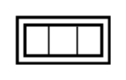
2. Data Link Layer (DLL) (Layer 2) :
The data link layer is responsible for the node to node delivery of the message. The main function of this layer is to make sure data transfer is error-free from one node to another, over the physical layer. When a packet arrives in a network, it is the responsibility of DLL to transmit it to the Host using its MAC address.
Data Link Layer is divided into two sub layers :
Logical Link Control (LLC)
Media Access Control (MAC)
The packet received from Network layer is further divided into frames depending on the frame size of NIC(Network Interface Card). DLL also encapsulates Sender and Receiver’s MAC address in the header.
The Receiver’s MAC address is obtained by placing an ARP(Address Resolution Protocol) request onto the wire asking “Who has that IP address?” and the destination host will reply with its MAC address.
Switch & Bridge are Data Link Layer devices.

Slide 5

3. Network Layer (Layer 3) :
Network layer works for the transmission of data from one host to the other located in different networks. It also takes care of packet routing i.e. selection of the shortest path to transmit the packet, from the number of routes available. The sender & receiver’s IP address are placed in the header by the network layer. The functions of the Network layer are :
Routing: The network layer protocols determine which route is suitable from source to destination. This function of network layer is known as routing.
Logical Addressing: In order to identify each device on internetwork uniquely, network layer defines an addressing scheme. The sender & receiver’s IP address are placed in the header by network layer. Such an address distinguishes each device uniquely and universally
Segment in Network layer is referred as Packet.
Network layer is implemented by networking devices such as routers.

Slide 6
4. Transport Layer (Layer 4) :
Transport layer provides services to application layer and takes services from network layer. The data in the transport layer is referred to as Segments. It is responsible for the End to End Delivery of the complete message. The transport layer also provides the acknowledgement of the successful data transmission and re-transmits the data if an error is found.
The functions of the transport layer are :
Segmentation and Reassembly: This layer accepts the message from the (session) layer , breaks the message into smaller units . Each of the segment produced has a header associated with it. The transport layer at the destination station reassembles the message.
Service Point Addressing: In order to deliver the message to correct process, transport layer header includes a type of address called service point address or port address. Thus by specifying this address, transport layer makes sure that the message is delivered to the correct process.
The services provided by the transport layer :
Connection Oriented Service: It is a three-phase process which include – Connection Establishment – Data Transfer – Termination / disconnection In this type of transmission, the receiving device sends an acknowledgement, back to the source after a packet or group of packet is received. This type of transmission is reliable and secure.
Connection less service: It is a one-phase process and includes Data Transfer. In this type of transmission, the receiver does not acknowledge receipt of a packet. This approach allows for much faster communication between devices. Connection-oriented service is more reliable than connectionless Service.

Slide 7
5. Session Layer (Layer 5) :
This layer is responsible for establishment of connection, maintenance of sessions, authentication and also ensures security.
The functions of the session layer are :
Session establishment, maintenance and termination: The layer allows the two processes to establish, use and terminate a connection.
Synchronization : This layer allows a process to add checkpoints which are considered as synchronization points into the data. These synchronization point help to identify the error so that the data is re-synchronized properly, and ends of the messages are not cut prematurely and data loss is avoided.
Dialog Controller : The session layer allows two systems to start communication with each other in half-duplex or full-duplex.

Slide 8
6. Presentation Layer (Layer 6) :
Presentation layer is also called the Translation layer. The data from the application layer is extracted here and manipulated as per the required format to transmit over the network. The functions of the presentation layer are :
Translation : For example, ASCII to EBCDIC.
Encryption/ Decryption : Data encryption translates the data into another form or code. The encrypted data is known as the cipher text and the decrypted data is known as plain text. A key value is used for encrypting as well as decrypting data.
Compression: Reduces the number of bits that need to be transmitted on the network.

Slide 9

7. Application Layer (Layer 7) :
At the very top of the OSI Reference Model stack of layers, we find Application layer which is implemented by the network applications. These applications produce the data, which has to be transferred over the network. This layer also serves as a window for the application services to access the network and for displaying the received information to the user.
Ex: Application – Browsers, Skype Messenger etc. **Application Layer is also called as Desktop Layer.
The functions of the Application layer are :
Network Virtual Terminal
FTAM-File transfer access and management
Mail Services
Directory Services

Slide 10
TCP/IP vs OSI
TCP/IP | OSI
TCP refers to Transmission Control Protocol. | OSI refers to Open Systems Interconnection.
TCP/IP has 4 layers. | OSI has 7 layers.
TCP/IP is more reliable | OSI is less reliable
TCP/IP does not have very strict boundaries. | OSI has strict boundaries
TCP/IP follow a horizontal approach. | OSI follows a vertical approach.
TCP/IP uses both session and presentation layer in the application layer itself. | OSI uses different session and presentation layers.
TCP/IP developed protocols then model. | OSI developed model then protocol.
Transport layer in TCP/IP does not provide assurance delivery of packets. | In OSI model, transport layer provides assurance delivery of packets.
TCP/IP model network layer only provides connection less services. | Connection less and connection oriented both services are provided by network layer in OSI model.
Protocols cannot be replaced easily in TCP/IP model. | While in OSI model, Protocols are better covered and is easy to replace with the change in technology.

Slide 11
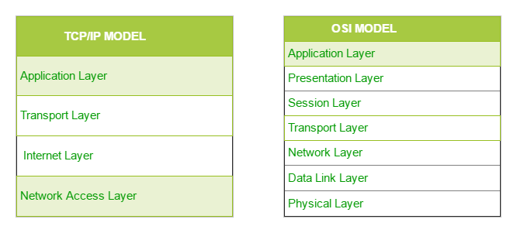
Layers of TCP/IP & OSI
7
6
5
4
3
2
1

Slide 12
1. Network Access Layer –
This layer corresponds to the combination of Data Link Layer and Physical Layer of the OSI model. It looks out for hardware addressing and the protocols present in this layer allows for the physical transmission of data.
We just talked about ARP being a protocol of Internet layer, but there is a conflict about declaring it as a protocol of Internet Layer or Network access layer. It is described as residing in layer 3, being encapsulated by layer 2 protocols.
2. Internet Layer –
This layer parallels the functions of OSI’s Network layer. It defines the protocols which are responsible for logical transmission of data over the entire network. The main protocols residing at this layer are :
IP – stands for Internet Protocol and it is responsible for delivering packets from the source host to the destination host by looking at the IP addresses in the packet headers. IP has 2 versions: IPv4 and IPv6. IPv4 is the one that most of the websites are using currently. But IPv6 is growing as the number of IPv4 addresses are limited in number when compared to the number of users.
ICMP – stands for Internet Control Message Protocol. It is encapsulated within IP datagrams and is responsible for providing hosts with information about network problems.
ARP – stands for Address Resolution Protocol. Its job is to find the hardware address of a host from a known IP address. ARP has several types: Reverse ARP, Proxy ARP, Gratuitous ARP and Inverse ARP.

Slide 13
3. Host-to-Host Layer –
This layer is analogous to the transport layer of the OSI model. It is responsible for end-to-end communication and error-free delivery of data. It shields the upper-layer applications from the complexities of data. The two main protocols present in this layer are :
Transmission Control Protocol (TCP) – It is known to provide reliable and error-free communication between end systems. It performs sequencing and segmentation of data. It also has acknowledgment feature and controls the flow of the data through flow control mechanism. It is a very effective protocol but has a lot of overhead due to such features. Increased overhead leads to increased cost.
User Datagram Protocol (UDP) – On the other hand does not provide any such features. It is the go-to protocol if your application does not require reliable transport as it is very cost-effective. Unlike TCP, which is connection-oriented protocol, UDP is connectionless.

Slide 14
4. Application Layer –
This layer performs the functions of top three layers of the OSI model: Application, Presentation and Session Layer. It is responsible for node-to-node communication and controls user-interface specifications. Some of the protocols present in this layer are: HTTP, HTTPS, FTP, TFTP, Telnet, SSH, SMTP, SNMP, NTP, DNS, DHCP, NFS, X Window, LPD. Protocols other than those present in the linked article are :
HTTP and HTTPS – HTTP stands for Hypertext transfer protocol. It is used by the World Wide Web to manage communications between web browsers and servers. HTTPS stands for HTTP-Secure. It is a combination of HTTP with SSL(Secure Socket Layer). It is efficient in cases where the browser need to fill out forms, sign in, authenticate and carry out bank transactions.
SSH – SSH stands for Secure Shell. It is a terminal emulations software similar to Telnet. The reason SSH is more preferred is because of its ability to maintain the encrypted connection. It sets up a secure session over a TCP/IP connection.
NTP – NTP stands for Network Time Protocol. It is used to synchronize the clocks on our computer to one standard time source. It is very useful in situations like bank transactions. Assume the following situation without the presence of NTP. Suppose you carry out a transaction, where your computer reads the time at 2:30 PM while the server records it at 2:28 PM. The server can crash very badly if it’s out of sync.

Slide 15
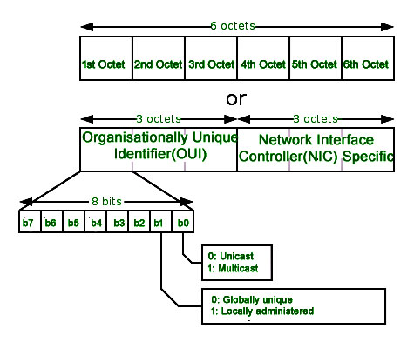
Introduction of MAC Address
In order to communicate or transfer the data from one computer to another computer we need some address. In Computer Network various types of address are introduced; each works at different layer. Media Access Control Address is a physical address which works at Data Link Layer.
Media Access Control (MAC) Address –
MAC Addresses are unique 48-bits hardware number of a computer, which is embedded into network card (known as Network Interface Card) during the time of manufacturing. MAC Address is also known as Physical Address of a network device. In IEEE 802 standard, Data Link Layer is divided into two sublayers –
Logical Link Control(LLC) Sublayer
Media Access Control(MAC) Sublayer
MAC address is used by Media Access Control (MAC) sublayer of Data-Link Layer. MAC Address is word wide unique, since millions of network devices exists and we need to uniquely identify each.

Slide 16
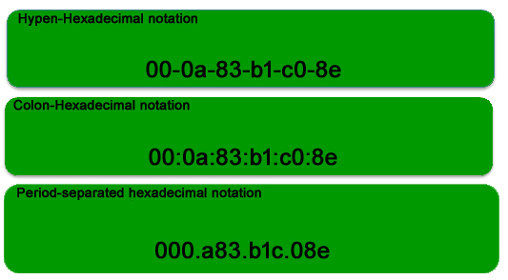
Format of MAC Address –
MAC Address is a 12-digit hexadecimal number (6-Byte binary number), which is mostly represented by Colon-Hexadecimal notation. First 6-digits (say 00:40:96) of MAC Address identifies the manufacturer, called as OUI (Organizational Unique Identifier). IEEE Registration Authority Committee assign these MAC prefixes to its registered vendors.
eg: 3C:D9:2B-HP
The rightmost six digits represents Network Interface Controller, which is assigned by manufacturer.
As discussed above, MAC address is represented by Colon-Hexadecimal notation. But this is just a conversion, not mandatory. MAC address can be represented using any of the following formats –
Note: Colon-Hexadecimal notation is used by Linux OS and Period-separated Hexadecimal notation is used by Cisco Systems.

Slide 17
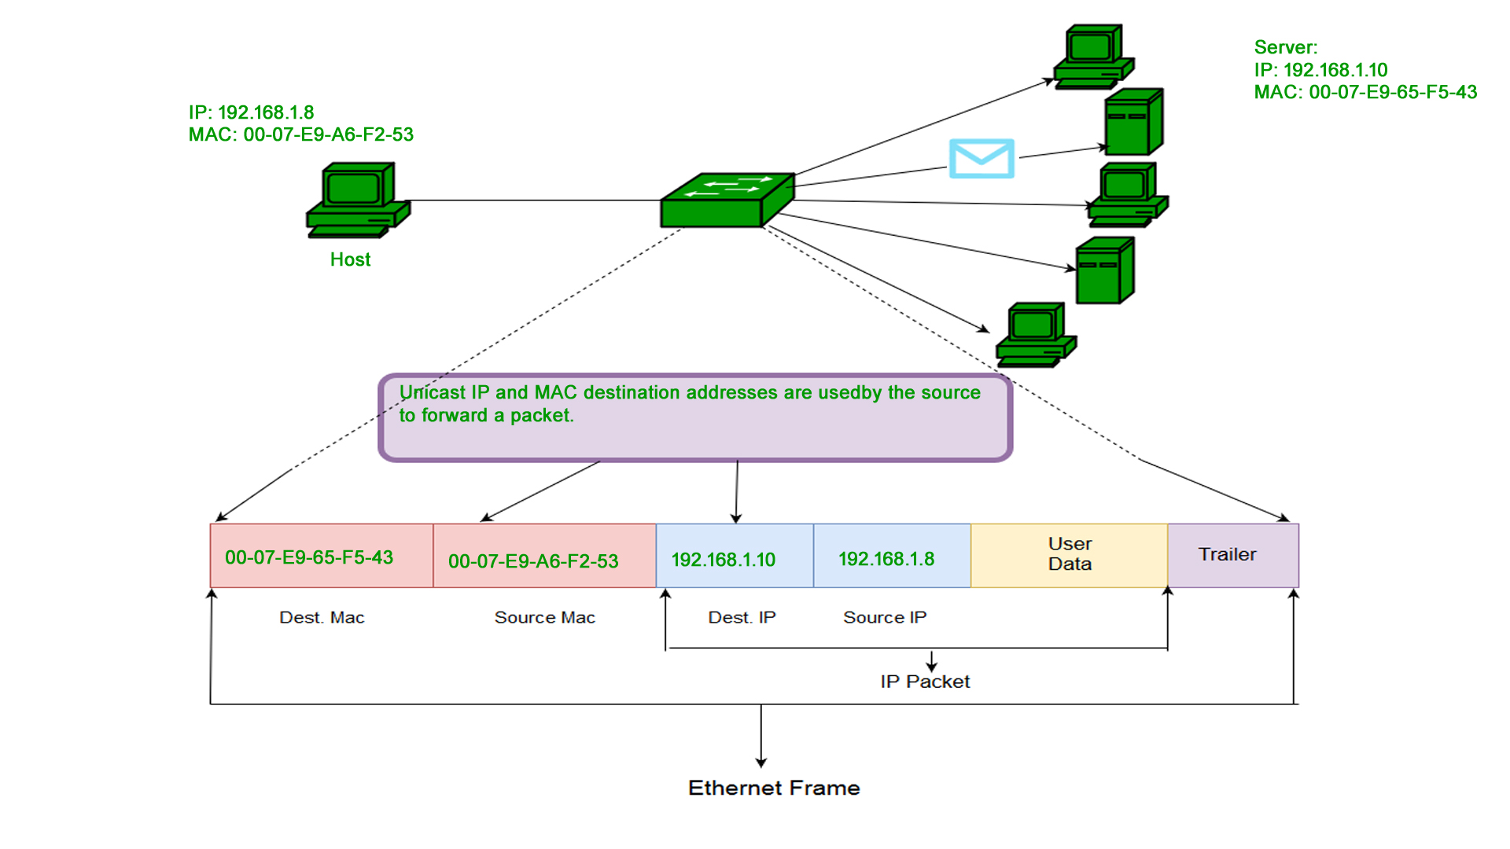
Types of MAC Address –
Unicast – A Unicast addressed frame is only sent out to the interface leading to specific NIC. If the LSB (least significant bit) of first octet of an address is set to zero, the frame is meant to reach only one receiving NIC. MAC Address of source machine is always Unicast.

Slide 18
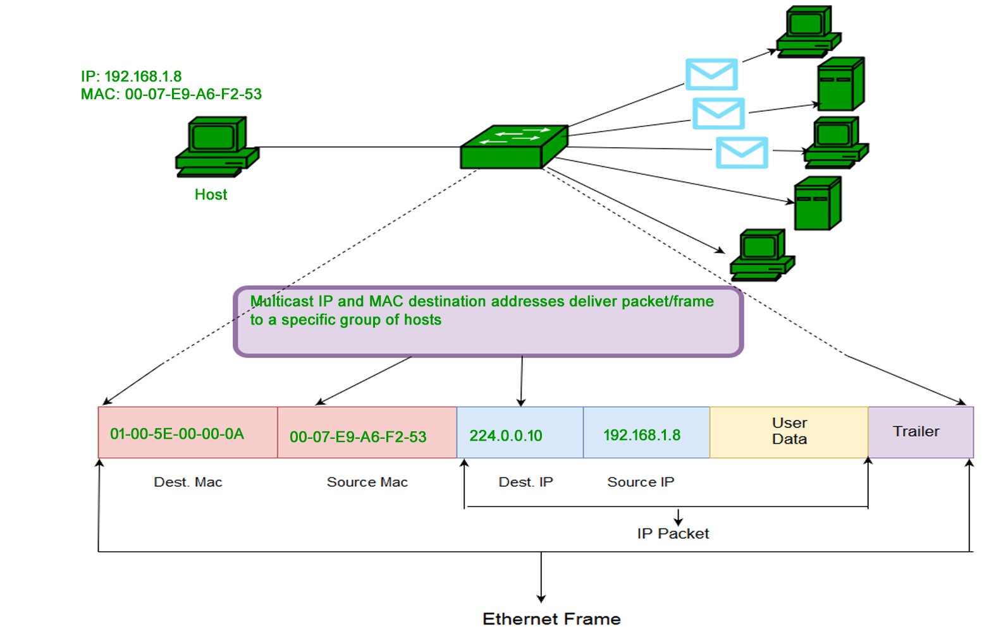
Multicast – Multicast address allow the source to send a frame to group of devices. In Layer-2 (Ethernet) Multicast address, LSB (least significant bit) of first octet of an address is set to one. IEEE has allocated the address block 01-80-C2-xx-xx-xx (01-80-C2-00-00-00 to 01-80-C2-FF-FF-FF) for group addresses for use by standard protocols.

Slide 19
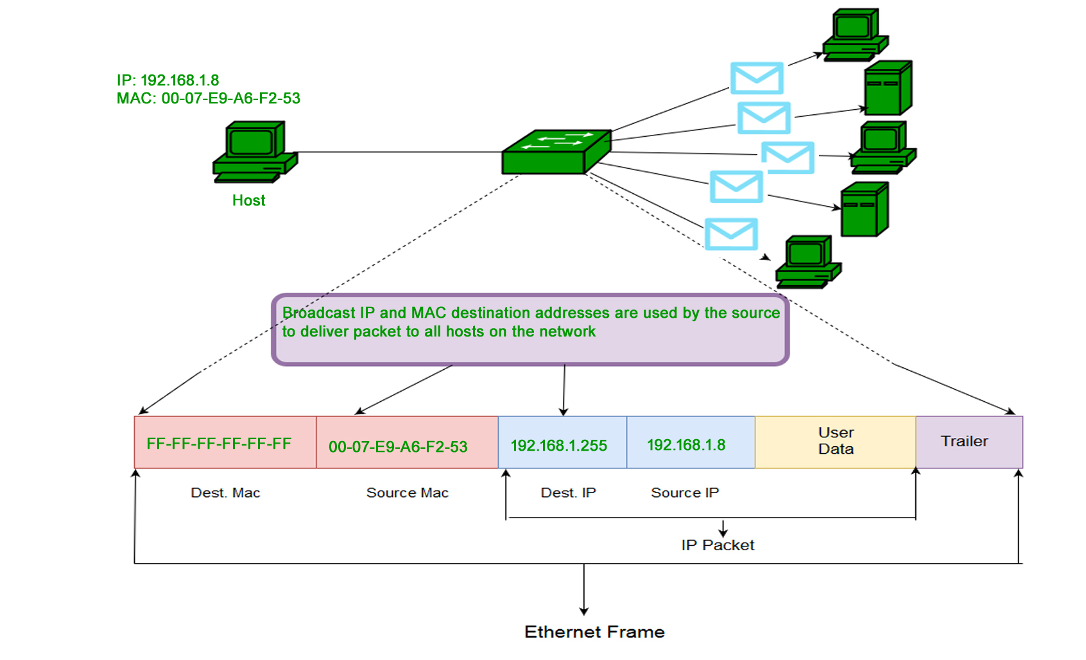
Broadcast – Similar to Network Layer, Broadcast is also possible on underlying layer( Data Link Layer). Ethernet frames with ones in all bits of the destination address (FF-FF-FF-FF-FF-FF) are referred as broadcast address. Frames which are destined with MAC address FF-FF-FF-FF-FF-FF will reach to every computer belong to that LAN segment.

Slide 20
IP ADDRESSING

Slide 21
What is an Internet Protocol
Protocol used for communicating data
Across a packet-switched
IP usage
Used to connect to another computer
Allows transfers of files and e-mail

Slide 22
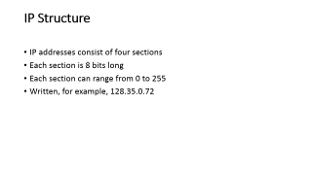
What is an IP address
An IP address is a 32-bit sequence of 1s and 0s.
A way to identify machines on a network
A unique identifier
A numerical label
Part of IP Address
Network Part
Local or Host Part

Slide 23
IP Structure
IP addresses consist of four sections
Each section is 8 bits long
Each section can range from 0 to 255
Written, for example, 128.35.0.72

Slide 24
IP structure
5 Classes of IP address A B C D and E
Class A reserved for governments
Class B reserved for medium companies
Class C reserved for small companies
Class D are reserved for multicasting
Class E are reserved for future use
CLASS A- ADDRESS RANGE- 0-127
CLASS B- ADDRESS RANGE- 128-192
CLASS C- ADDRESS RANGE- 192-223
CLASS D- ADDRESS RANGE- 224-239
CLASS E- ADDRESS RANGE- 240-255

Slide 25
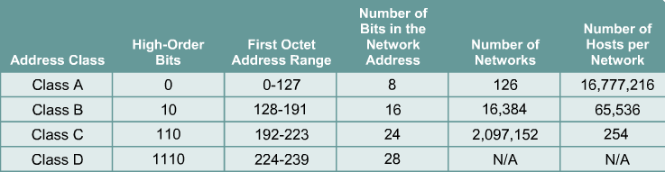
IP addresses are divided into
classes A,B and C to define large, medium, and small networks.

Slide 26
IP versions
IPv4: 32-bit* number: Written in Dotted Decimal or Binary
Notation
205.150.58.7 (Dotted Decimal ), 00000010 00000011 00000110 00001111
4 billion different host addresses
IPv6: 128-bit* number: Written in Hex Decimal
Notation
2001:0503:0C27:0000:0000:0000:0000:0000
16 billion network addresses

Slide 27
Private IP Address and Public IP Address are used to uniquely identify a machine on the internet. Private IP address is used with a local network and public IP address is used outside the network. Public IP address is provided by ISP, Internet Service Provider.
Reserved for private networks.
The organizations that distribute IP addresses to the world reserves a range of IP addresses for private networks.
192.168.0.0 – 192.168.255.255 (65,536 IP addresses)
172.16.0.0 – 172.31.255.255 (1,048,576 IP addresses)
10.0.0.0 – 10.255.255.255 (16,777,216 IP addresses)

Slide 28
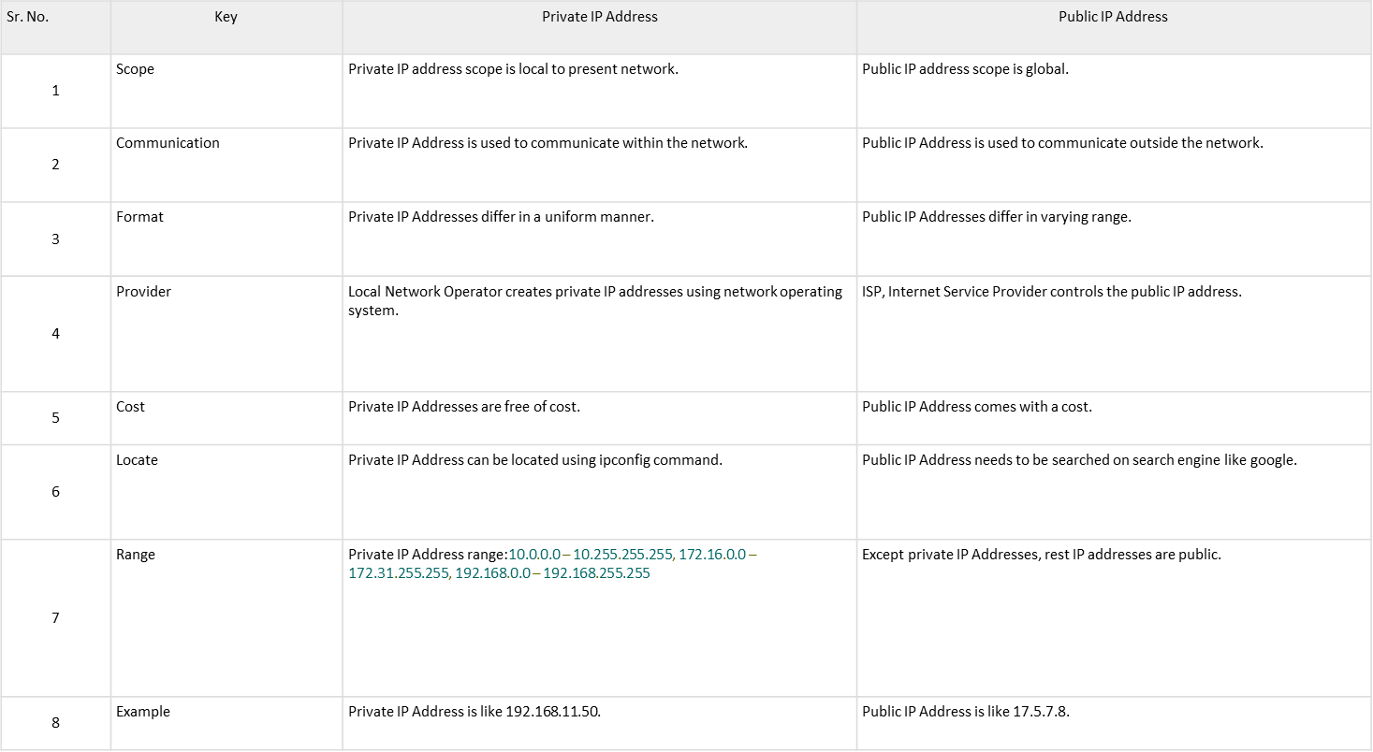

Slide 29
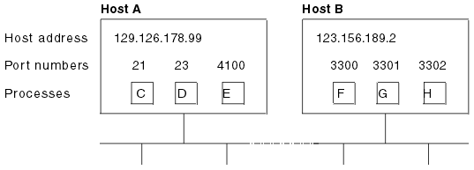
TCP ADDRESSES
TCP/IP provides for process-to-process communication, which means that calls need an addressing scheme that specifies both the physical host connection (Host A and Host B in Figure and the software process or application (C, D, E, F, G, and H). The way this is done in TCP/IP is for calls to specify the host by an internet address and the process by a port number. You may find internet addresses also referred to elsewhere as internet protocol (IP) addresses or host IDs.
How applications are addressed

Slide 30
IP addresses Each server or client on a TCP/IP internet is identified by a numeric IP (Internet Protocol) address. The two types of IP address are the IPv4 (IP version 4) address and the IPv6 (IP version 6) address.
Port numbers (for servers) An incoming connection request specifies the server that it wants by specifying the server’s port number.
Port numbers (for clients) Client applications must also identify themselves with port numbers so that server applications can distinguish different connection requests.

